Slide 1
Linear Models: Regression and ANOVA
Devin, Ruby, and Raine

Slide 2
Linear Models
The general form of a linear model is the equation of a line:
Y= b + mX
response variable (Y) = constant + slope*explanatory variable (X)
linear regression and ANOVA both involve a response variable that can be represented by a linear model plus random error
regression = numerical explanatory variable
ANOVA = categorical explanatory variable

Slide 3
Linear Models as Stochastic Models
deterministic model: exact relationship between X and Y
stochasticity: scatter of Y measurements around the model predictions due to random error
statistical models can be written in terms of a deterministic part and a stochastic part:
deterministic: μ_{i} = F(X_{1i}, X_{2i}, …)
stochastic: Y_{i} ~ Distribution (μ_{i})
The expected value μ_{i} of the response variable is a function of the explanatory variables X_{1i}, X_{2i}, …
the observed value Y_{i} is a random draw from a probability distribution with a mean equal to μ_{i}

Slide 4
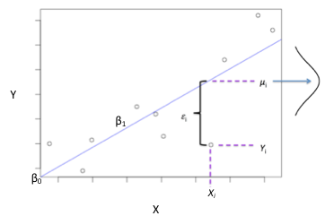
Linear Regression
Regression predicts values of a numerical response variable (Y) from values of one or more numerical explanatory variables (X)
linear regression fits a straight line through the data. The bivariate linear regression model can be written as:
Y_{i}=β₀ + β₁X_{i} + ε_{i}, where ε_{i}~N(0, σ²)
Or, equivalently:
μ_{i}=β₀ + β₁X_{i}, where Y_{i}~N(μ_{i}, σ²)
β₀= intercept, β₁ =slope, μ_{i} =expected value of Y,
Y_{i} =observed value of Y, and ε_{i} =Y_{i} –μ_{i}=residual for individual i

Slide 5
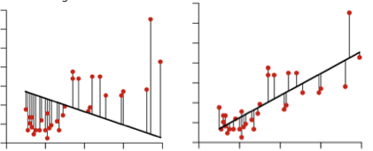
Each observation has a residual ε_{i} , the difference between the observed value of Y and the value predicted by the regression line
μ_{i}=β₀ + β₁X_{i}, where Y_{i}~N(μ_{i}, σ²)
ε_{i} =Y_{i} –μ_{i}
the fitted line is the least squares regression line: the fitted intercept and slope coefficients are those that minimize the sum of the residuals squared
Large Σε²
Minimum Σε²

Slide 6
the intercept β₀ and the slope β₁ are the unknown population parameters that we want to estimate by fitting our data to the regression line
β₀ represents the value of Y when X=0
β₁ represents the rate of change in Y per unit X
The fit of the model is evaluated by comparing it to a null model with a slope of zero:
H₀: β₁ =0 (Y= β₀’ )
H_{A}: β₁ ≠ 0 (Y = β₀ + β₁X)

Slide 7
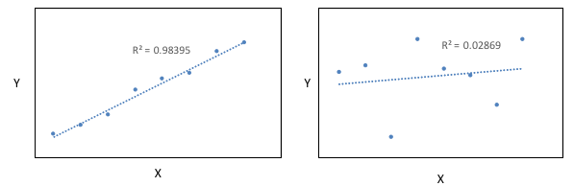
R² measures the fraction of variation in Y that is explained by X in the linear regression model
R² of 1 means X explains 100% of the variation in Y, R² of close to 0 means X explains little of the variation in Y

Slide 8
Multiple (Multivariate) Regression
for j explanatory variables, the model of multiple linear regression is given by:
Y_{i}=β₀ + β₁X_{1i} + β₂X_{2i} +...+ β_{j}X_{ji} +ε_{i}, where ε_{i}~N(0, σ²)
the partial regression coefficient β_{j} is interpreted as the mean change in Y for each unit change in X_{j} when all other X’s are held constant
the model may also include interaction effects between explanatory variables
ex. an interaction between X₁ and X₂ would be included as
Y_{i}=β₀ + β₁X_{1i} + β₂X_{2i} +β₃X_{1i}*X_{2i}+...+ β_{j}X_{ji} +ε_{i}

Slide 9
Assumptions of Linear Regression
Linear relationship between the response and explanatory variables
can check with a scatterplot
some non-linear relationships can be made linear by transforming the data

Slide 10
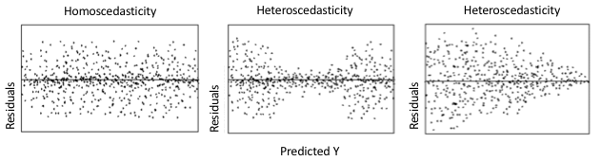
Assumptions of Linear Regression
2) Homoscedasticity: variance of the residuals is the same across X values
check with a residual plot (plot the residuals against fitted Y values)
violations may be fixed with data transformation (square root, log, arcsine)

Slide 11
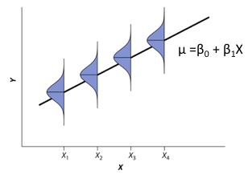
Assumptions of Linear Regression
3) Normality: at each value of X, the distribution of possible Y values is normal
check with a histogram or QQ-plot of the residuals

Slide 12
Assumptions of Linear Regression
4) No Multicollinearity (for multivariate regression): if explanatory variables are highly correlated, it is difficult for the model to estimate the relationship between each explanatory variable and the response variable independently of the other explanatory variables
can check for correlation with Variance Inflation Factors (VIFs)
5) Fixed X: the explanatory variables are deterministic (as little measurement error as possible)
not an issue if the measurement error is small compared to the range of X values

Slide 13
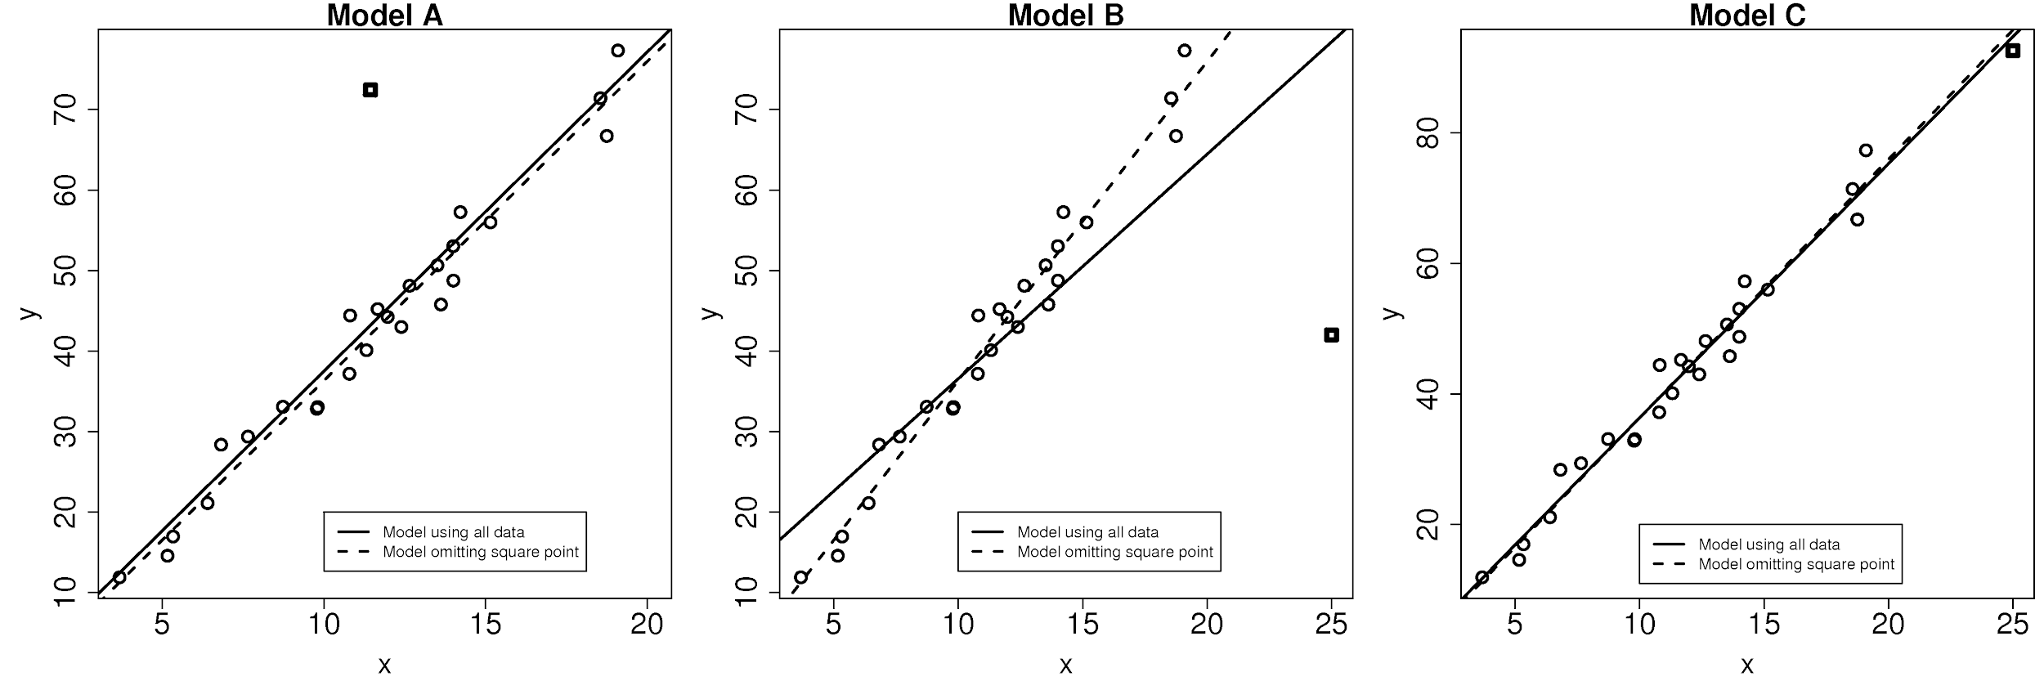
Additional Issues To Be Aware Of
Extrapolation: regression should rarely be used to predict the values of a response variable outside the range of X-values in the data
Influential points: can violate assumptions & bias model fit and results
Outliers (extreme Y values) don’t follow the main trend
Points of high leverage have extreme X values
Can use Cook’s Distance to check for influential points
Notes:
*

Slide 14

Improving the Interpretability of Regression Coefficients
Centering: (subtract the mean from each observation)
in the multiple regression model
Y_{i}=β₀ + β₁X_{1i} + β₂X_{2i} +β₃X_{1i}*X_{2i}+ε_{i}
X₁ and X₂ are correlated with the term X₁*X₂, resulting in multicollinearity
Mean centering of X₁ and X₂ will reduce these correlations, enabling the main effects of X₁ and X₂ to be interpreted

Slide 15

Improving the Interpretability of Regression Coefficients
Subtract the mean from each observation and divide by the standard deviation
Standardization:
converts the original units of a variable to units of standard deviations, allowing for comparison of the explanatory value of predictors with different units
the partial regression coefficients of standardized variables are called standardized partial regression coefficients (SPRCs), denoted as b*_{xy|y}
note: the partial correlation coefficient (PCC) r_{xy|z} is an alternative estimate that can be used as a standardized effect size

Slide 16
Building A Linear Model
(see Appendix A of Zuur 2009)
Initial Data Analyses to check for:
outliers in response variables, explanatory variables with high leverage
collinearity of explanatory variables
relationship between explanatory and response variable (is it linear?)
Model selection
decide which explanatory variables and interaction terms to include
Model Validation
check that the model assumptions are met

Slide 17
ANOVA: Analysis of Variance
Many studies involve comparisons between more than two groups of subjects.
ANOVA can be used to compare the means between groups if the outcome is numerical
Why not use multiple t-tests?
Well, you’d end up doing a lot of t-tests the more groups you have
ANOVA lets you identify if any two of the group means are significantly different with one test!

Slide 18

ANOVA Hypotheses
The Null hypothesis for ANOVA is that the means for all groups are equal:
The Alternative hypothesis for ANOVA is that at least two of the means are not equal:
The test statistic for ANOVA is the ANOVA F-statistic.
If the ANOVA F-statistic is significant, further comparisons can be done to determine which groups have significantly different means.

Slide 19
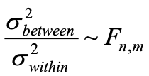
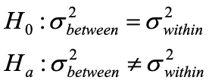
F-test
A comparison of the average variability between groups to the average variability within groups
A ratio of variance follows an F-distribution:
The F-test tests the hypothesis that two variances are equal.
F will be close to 1 if the sample variances are equal.

Slide 20
F-test continued
If variability between groups is large relative to the variability within groups, the F-statistic will be large.
If variability between groups is similar or smaller than the variability within groups, the F-statistic will be small.
If the F-statistic is large enough, the null hypothesis that all means are equal is rejected.

Slide 21
ANOVA Assumptions
The observations are from a random sample and they are independent from each other
The observations are normally distributed within each group
ANOVA is still appropriate if this assumption is not met when the sample size in the group is at least 30
The variances are approximately equal between groups
If the ratio of the largest SD/small SD <2, this assumption is considered to be met
It is not required to have equal samples sizes in all groups

Slide 22
Let’s move to R Studio!

